Slide 1
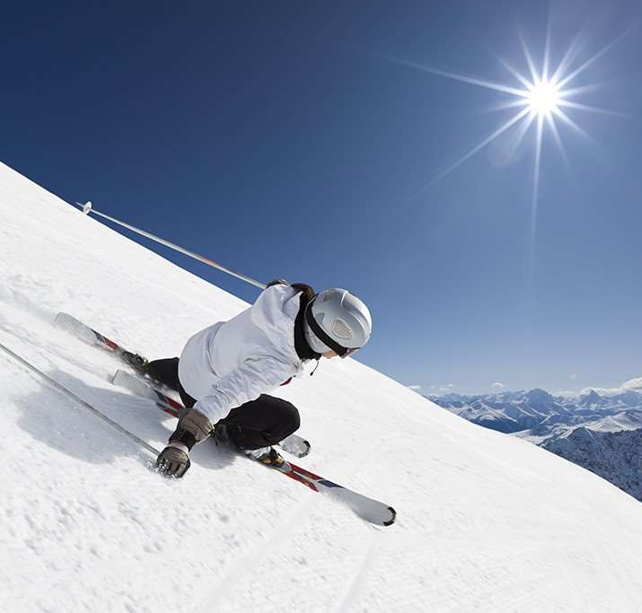
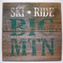
Big Mountain Ski Resort
A Ticket Pricing Strategy
Informed by Data-driven
Market Analysis

Slide 2
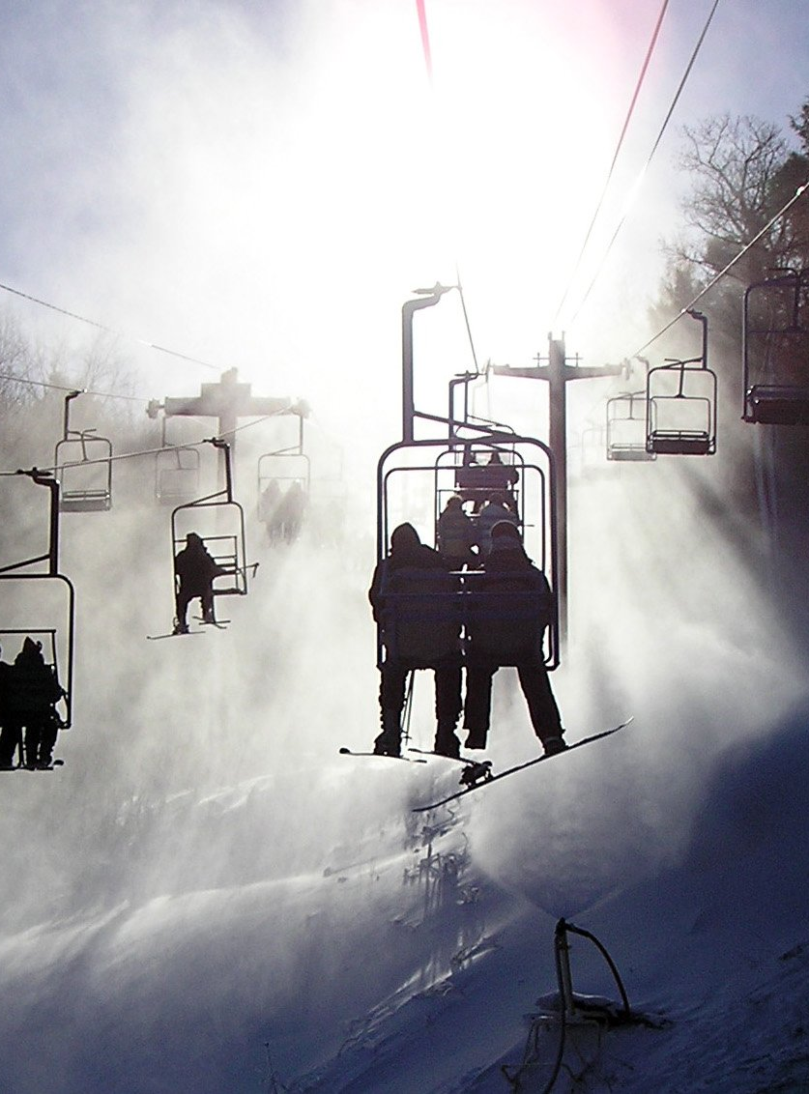
Problem Identification
Big Mountain Resort, a Whitefish, Montana ski resort
Recently installed chair lift to increase distribution of visitors across the mountain
Investment increased operating costs by ~$1.5 million
Current Ticket Pricing model is market-average based

Slide 3
Problem Identification
Data-informed Pricing Model Goals:
Pricing model recouping $1.54m in expansion-related operating costs this year
Maintain current profit margins
Highlight market facility/amenity advantages
Forecast anticipated annual revenue impacts for future seasons

Slide 4

Recommendation & Key Findings
Add an Additional Chairlift
Increases vertical drop
Adds additional chairlift
Allows for an increased price by $1.99 dollars
Annual revenue increase of over $2.3 million (target $1.5m)

Slide 5
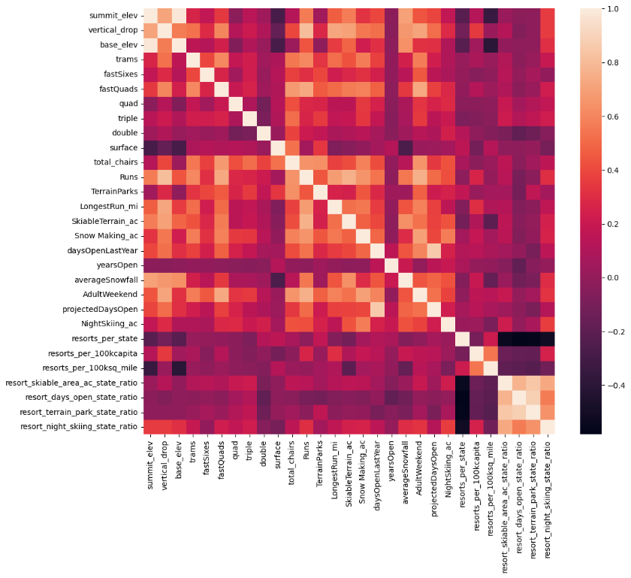
Modeling Results & Analysis
Features of all U.S. based ski resorts examined:
geographic location & demographic data
average ticket prices
average annual snow fall (etc.)
Strong positive correlation between ticket price and the following features:
vertical drop
snow-making acreage
## of chairs and ## of runs.
Negative correlations also observed:
State population and density of resorts

Slide 6
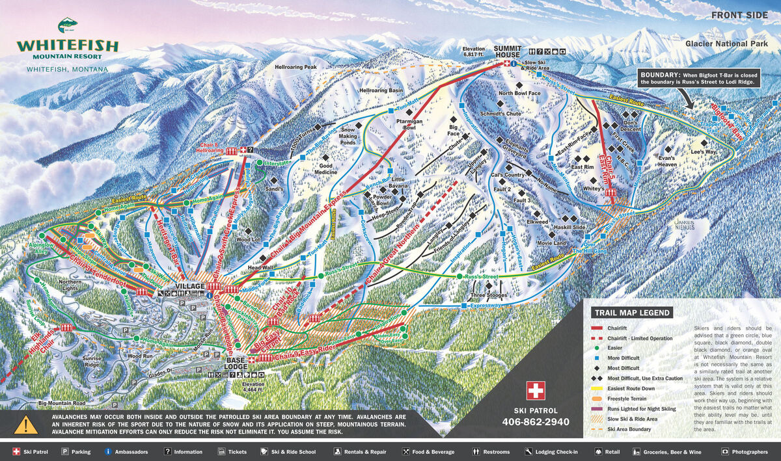
Modeling Results & Analysis
The analysis modeled the relationship between ticket price, and the following ratio-integrated variables:
total number of chairs +
total number of runs
total number of chairs +
skiable acreage
total number of fastQuad lifts +
total number of runs
total number of fastQuad lifts +
skiable acreage

Slide 7
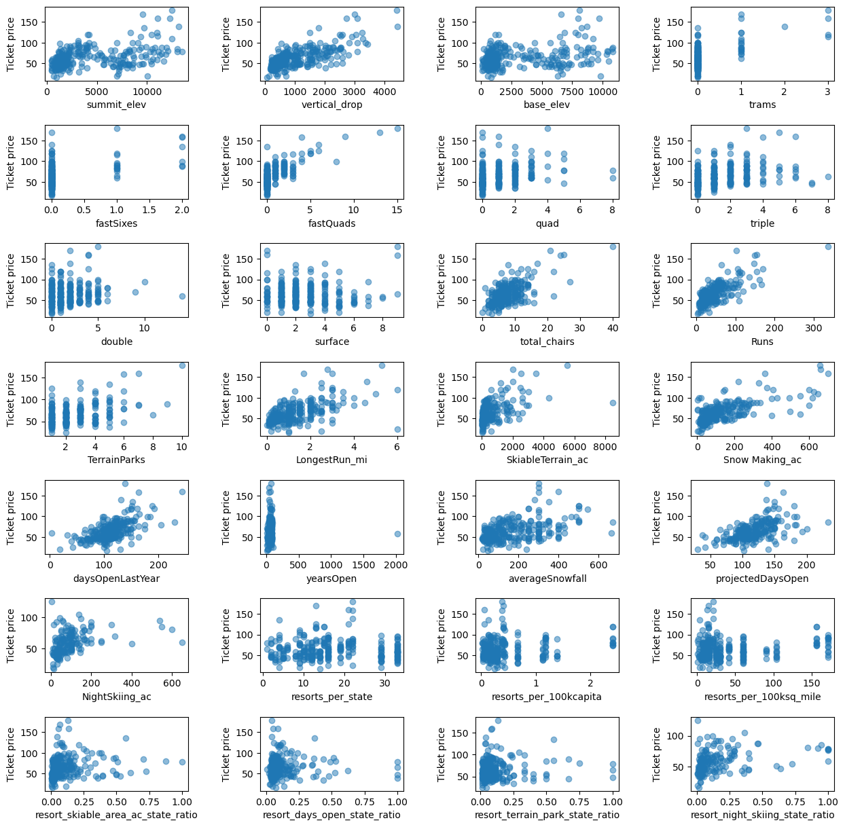
Modeling Results & Analysis
Multiple data models tested
Current model chosen for precision and accuracy
Big Mountain Resort Advantages
Number of ski runs
Number of chairlifts
Vertical drop total

Slide 8
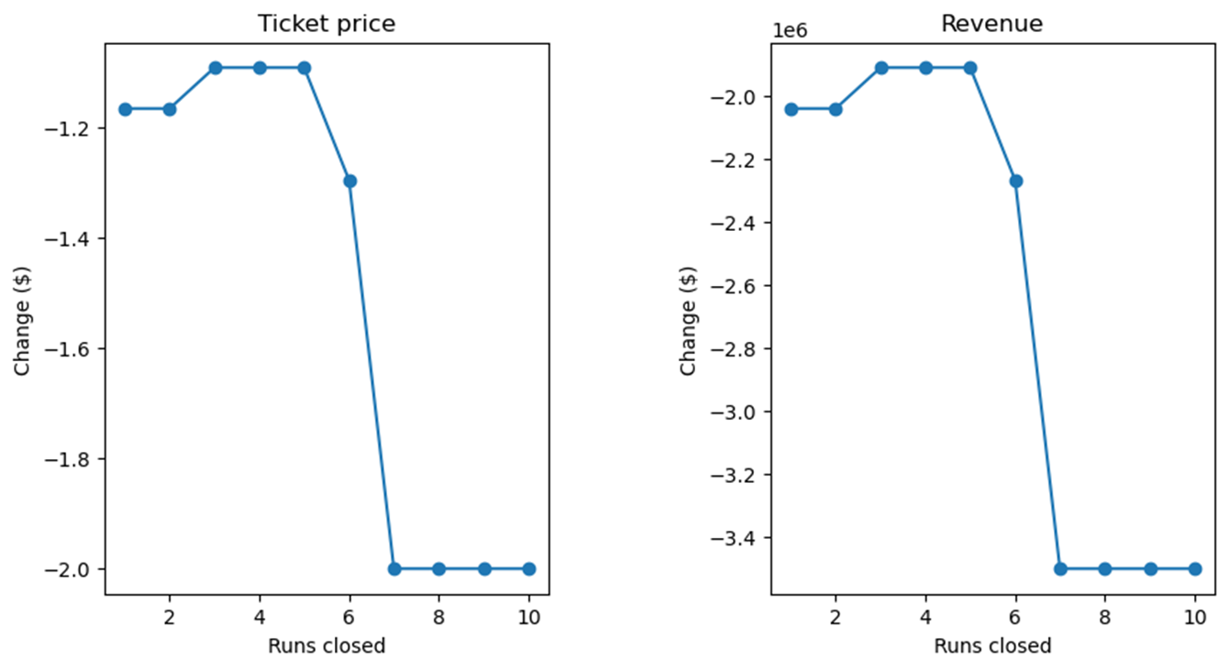
Modeling Results & Analysis
No pricing advantages gained with:
Increased length of longest run
Increased snow coverage area
Run Closures
Closing one run may yield modest ticket price increase
Ticket price experiences significant drop-off with every run closure thereafter

Slide 9
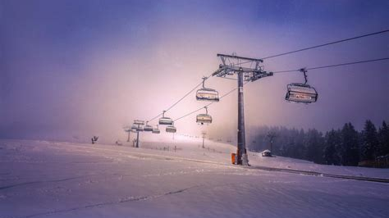
Adding an Additional Run
Increases vertical drop, adds additional chairlift
Lift ticket increase of $1.33 dollars
Annual revenue increase of over $2.3 million (target $1.54m)
Summary & Conclusion

